Slide 1






Voting Web Application
Student Details
Name:Divya P S
NM Id: au922221104301
College Name: Theni kammavar sangam college of technology

Slide 2

Project Outline
Voting Web Application
Abstract
Problem Statement
Aims, Objective & Proposed System/Solution
System Deployment Approach
Model Development & Algorithm
Future Scope
Conclusion
Reference

Slide 3


Voting Web Application
Abstract
This abstract outlines the development of a comprehensive voting application aimed at enhancing democratic processes and citizen engagement. The voting app utilizes modern technology to streamline the voting process, ensuring accessibility, security, and efficiency. Key features include voter registration, candidate information dissemination, secure ballot casting, and real-time result tracking. The app employs robust encryption techniques to safeguard voter data and prevent tampering or fraud. Additionally, it offers multi-platform compatibility, enabling users to vote conveniently via smartphones, tablets, or desktop computers. The development of this voting app underscores a commitment to democratization, transparency, and civic participation in the digital age.

Slide 4


Voting Web Application
Problem Statement
Traditional paper-based voting systems are inefficient, prone to errors, and vulnerable to fraud, while accessibility barriers hinder participation. The COVID-19 pandemic has underscored the need for secure and accessible remote voting options. A robust voting application is essential to overcome these challenges, ensuring security, transparency, and inclusivity in the democratic process.
Such an application must offer user-friendly interfaces, robust encryption, and multi-platform compatibility. It should also address concerns regarding data privacy and integrity. By leveraging technology, we can revitalize democratic participation and uphold the fundamental principles of fairness and accountability in elections.

Slide 5

Voting Web Application
Aim and Objective
Aim: An online voting app where users securely log in, cast their votes, and view real-time results. Utilizes end-to-end encryption to protect voter privacy and prevent tampering. Offers intuitive interface for seamless navigation and accessibility.

Slide 6
Voting Web Application
Objectives
User-friendly Interface: Ensure the app has an intuitive and easy-to-use interface for all users, regardless of their technological expertise.
Secure Authentication: Implement robust authentication methods to verify the identity of voters and prevent fraudulent activities.
Transparent Voting Process: Provide transparency throughout the voting process, including clear instructions, candidate information, and real-time updates on voting progress.
Accessibility: Ensure the app is accessible to all users, including those with disabilities, by incorporating features like screen readers and adjustable font sizes.
Reliability: Maintain a reliable voting system that can handle high traffic volumes without crashing or experiencing significant downtime.

Slide 7

Voting Web Application
Proposed Solution
Solution: A robust online voting app could be developed using a combination of blockchain technology for secure and transparent record-keeping, biometric authentication for voter verification, and multi-factor authentication to prevent unauthorized access.
The app would feature a user-friendly interface for easy navigation and accessibility, while incorporating stringent security measures to safeguard against hacking and tampering. Additionally, real-time auditing capabilities and voter verification mechanisms would ensure the integrity and reliability of the voting process.
Notes:
7

Slide 8
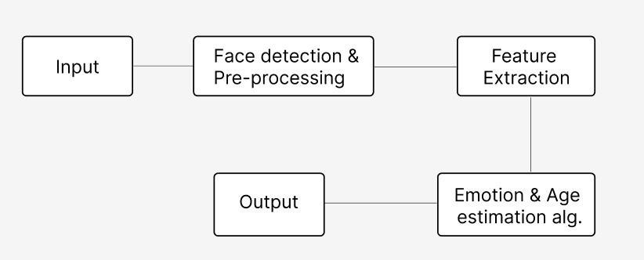
Voting Web Application
System Deployment Approach
Vote For Asked statements
Voting evaluation
login
Result
End of
Poll
Notes:
8

Slide 9
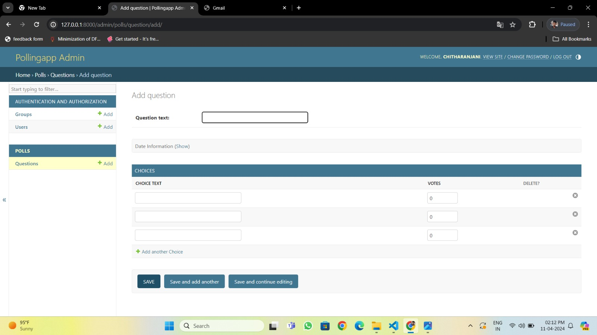
Voting Web Application
Result
Notes:
9

Slide 10
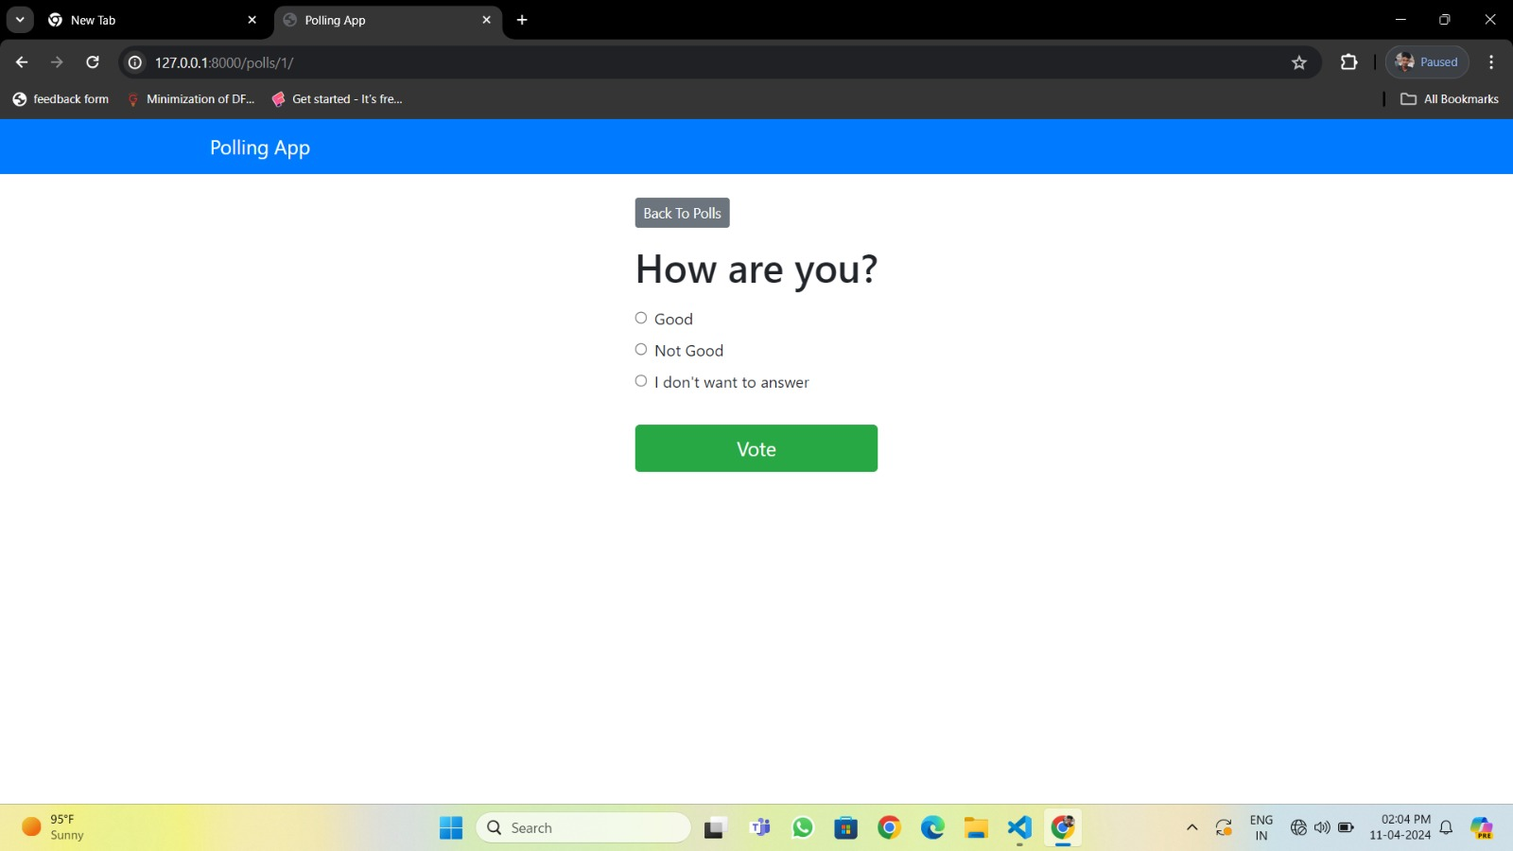
Voting Web Application
Result
Notes:
10

Slide 11
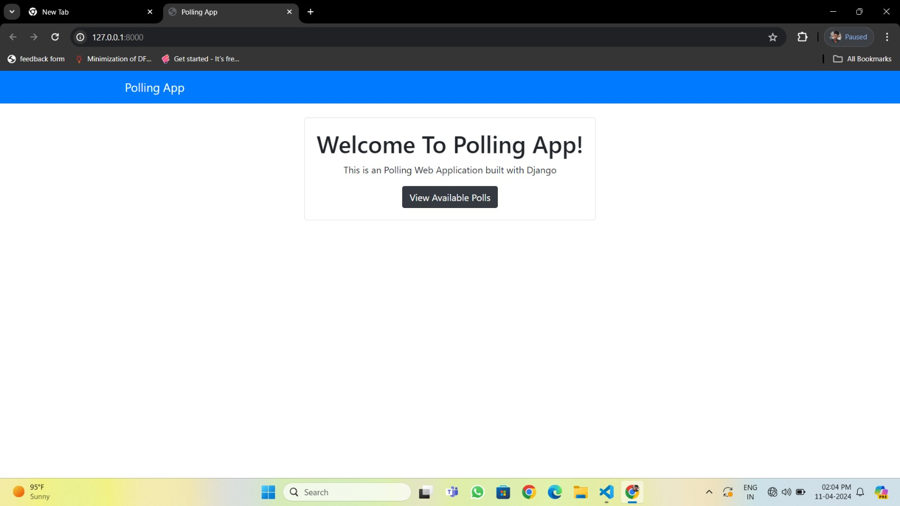
Voting Web Application
Result
Notes:
11

Slide 12

Voting Web Application
Future Scope
Convenience: By enabling voters to cast their votes from anywhere with an internet connection, online voting apps can increase voter turnout by removing barriers such as long queues, travel distance, and time constraints.
Cost-Effectiveness: Online voting can potentially reduce the costs associated with traditional paper-based voting systems, such as printing ballots, staffing polling stations, and transportation of election materials.
Notes:
12

Slide 13

Voting Web Application
Conclusion
Our project represents a significant advancement in online voting application.
online voting applications offer a promising avenue for enhancing accessibility, efficiency, and security in the electoral process.
However, their successful implementation requires rigorous attention to security measures, regulatory frameworks, and public trust-building efforts.
Notes:
13

Slide 14
Voting Web Application
Thank you!
Notes:
14

